Slide 1
Cards and KPIs
Power BI Card is useful to display a single number (or metric value). For example, If we want to track the total orders, total sales value.
The default Card visual in Power BI is a great visual to show you one single value; text, date, or number.
Use the card visual when you have a critical value that is important to communicate to your audience.
You can use a single card to highlight a single number that is most essential.
Multi-row cards can display one or more data points in an attractive and readable manner.

Slide 2
Key Performance Indicator(KPI)
Key Performance Indicator is a visual cue that shows visual measures of performance – progress made towards a measurable goal. It helps readers quickly see the status of the metric against a defined target.
It is used to gauge the performance of a value defined by a Base measure against a Target value.
Power BI KPI Visual answers two questions – measuring the distance to a goal, and measuring progress – how much progress has been made.
The purpose of KPIs is to help gauge business objectives and maintain the goal.
KPIs in Power BI requires these three values – Base value, Target Value, and Status thresholds.

Slide 3
Importance of KPIs
Monitor company financial health.
Measure progress against strategic goals.
Spot problems early on.
Make timely adjustments to tactics.
Motivate team members.
Make better decisions, faster.

Slide 4
How to Identify the KPIs
Start by clarifying your strategic objectives—collectively or by department.
Set goals which will help you identify which KPIs matter for your company.
Picking KPIs that are relevant will depend entirely on these objectives and the ability you have to measure your performance against them.
Identify the KPI targets that you’re working toward, and how they’ll be measured. Targets should be challenging.

Slide 5
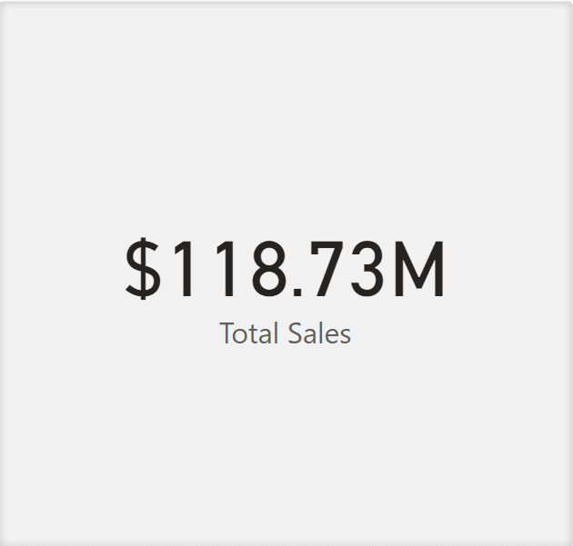
Single Card
Single row card visual is a single value displayed in a rectangular box.

Slide 6
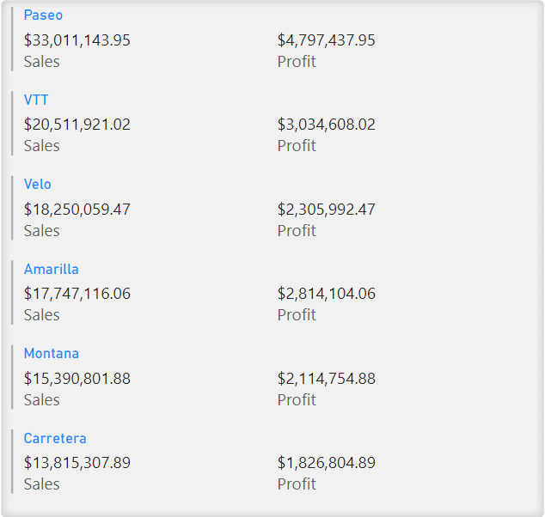
Multi-Row Card
The Multi-Row Card visual is used to display single values but in a group format or a section.
When creating a multi-row card you first create a column chart then you proceed to create a multi-row card.

Slide 7
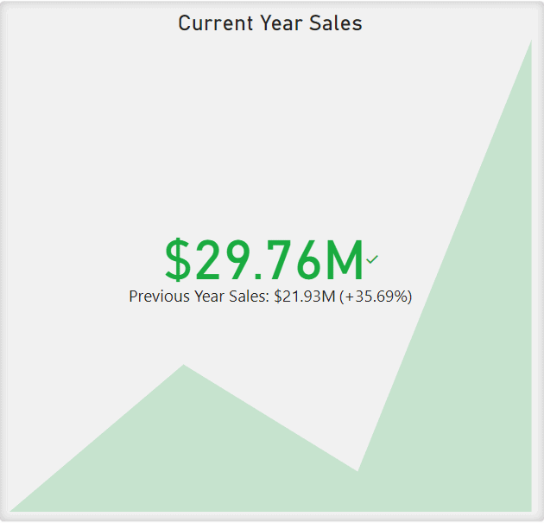
KPI visual
It usually contains the goal and the current progress as single values.
You can also add a trend axis to the visual that displays an Area Chart behind the values to represent the trend of progress over time.

